Slide 1
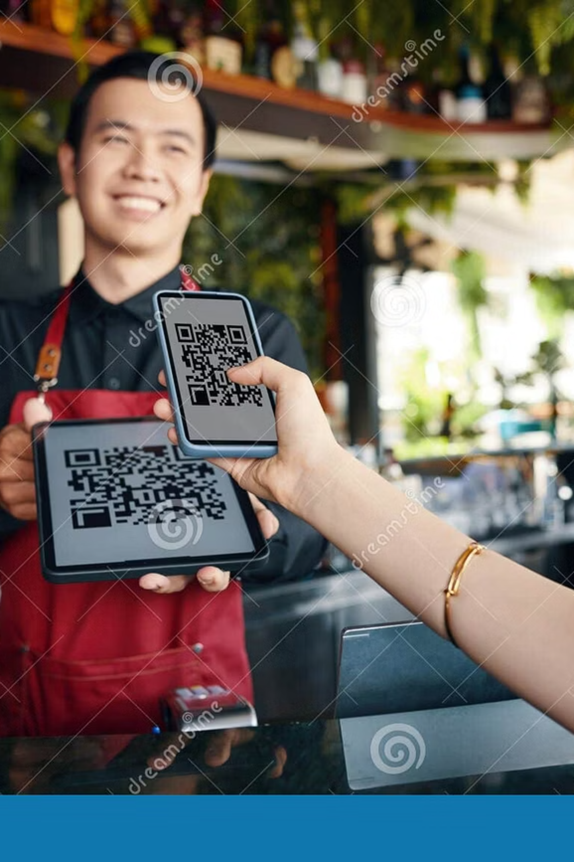
Restaurant Ordering System with QR-Based Ordering
A comprehensive full-stack web application designed to revolutionize restaurant management through digital innovation. This modern solution streamlines the entire ordering process with QR-based technology, serving the unique needs of restaurant administrators, staff members, and customers alike.

Slide 2
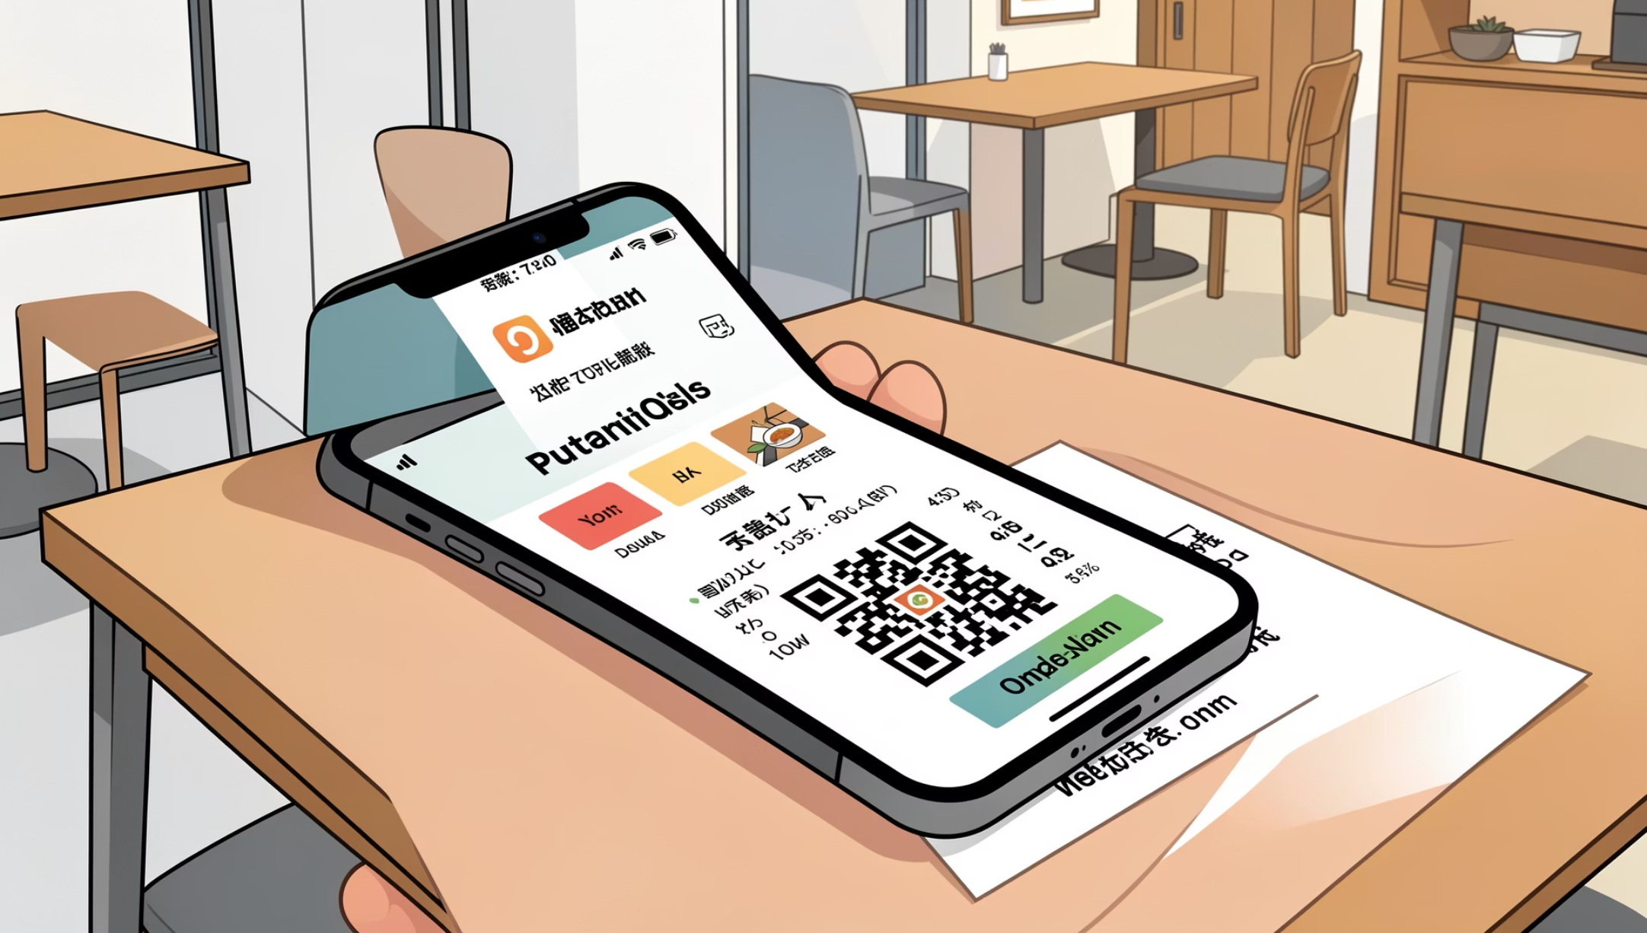
Transforming the Restaurant Experience
The digital transformation of restaurants begins with reimagining the ordering process. Our system eliminates traditional pain points by replacing manual order-taking with an intuitive, contactless solution that reduces errors and enhances efficiency.
By enabling QR-based menu access directly from customers' smartphones, we've created a seamless bridge between diners and kitchen staff. Real-time order tracking paired with comprehensive analytics empowers restaurant owners to make informed decisions while delivering exceptional service.

Slide 3
Powerful Technology Stack
Built on a robust foundation of modern web technologies, our system leverages industry-leading frameworks and tools to deliver reliability, performance, and scalability.
Frontend Layer
Backend Layer
Database
Integration Tools
React.js powers our dynamic user interface, while Tailwind CSS ensures responsive, beautiful design across all devices.
Node.js and Express.js provide a fast, scalable server architecture capable of handling high-volume restaurant operations.
MongoDB delivers cloud-based data storage with exceptional flexibility for restaurant data management.
JWT Authentication secures user access, Cloudinary handles image uploads, and automated QR code generation streamlines table setup.

Slide 4
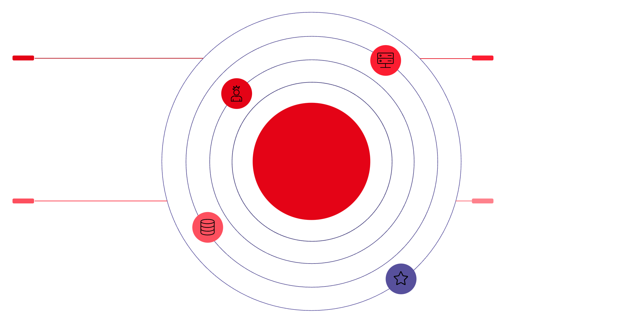

System Architecture & Design Patterns
Client-Server Architecture
Our system follows a clean separation of concerns with a React-based client communicating through RESTful APIs to an Express.js server. This architecture ensures maintainability and allows independent scaling of frontend and backend components.
Client Layer
Server Layer
React frontend sending REST requests
Express REST APIs with MVC structure
Three-Layer Architecture
MVC Pattern Implementation
Database Layer
MVC (Server)
Models: Define MongoDB schemas and data structures
Controllers: Handle business logic and request processing
Middleware: Manage authentication, validation, and security
MongoDB for document storage
Models, Controllers, Middleware

Slide 5

Backend Organization
controllers/
models/
middleware/
additionals/
Business logic orchestration for orders, authentication, analytics, and QR code management. Each controller handles specific feature domains with clear separation of responsibilities.
MongoDB schemas defining data structures for users, orders, menu items, restaurants, QR codes, and sessions. These models ensure data consistency and validation.
Authentication and authorization layers that protect routes and verify user permissions before processing requests.
Core utilities including JWT token handling, MongoDB connection management, and Cloudinary configuration for seamless image processing.

Slide 6
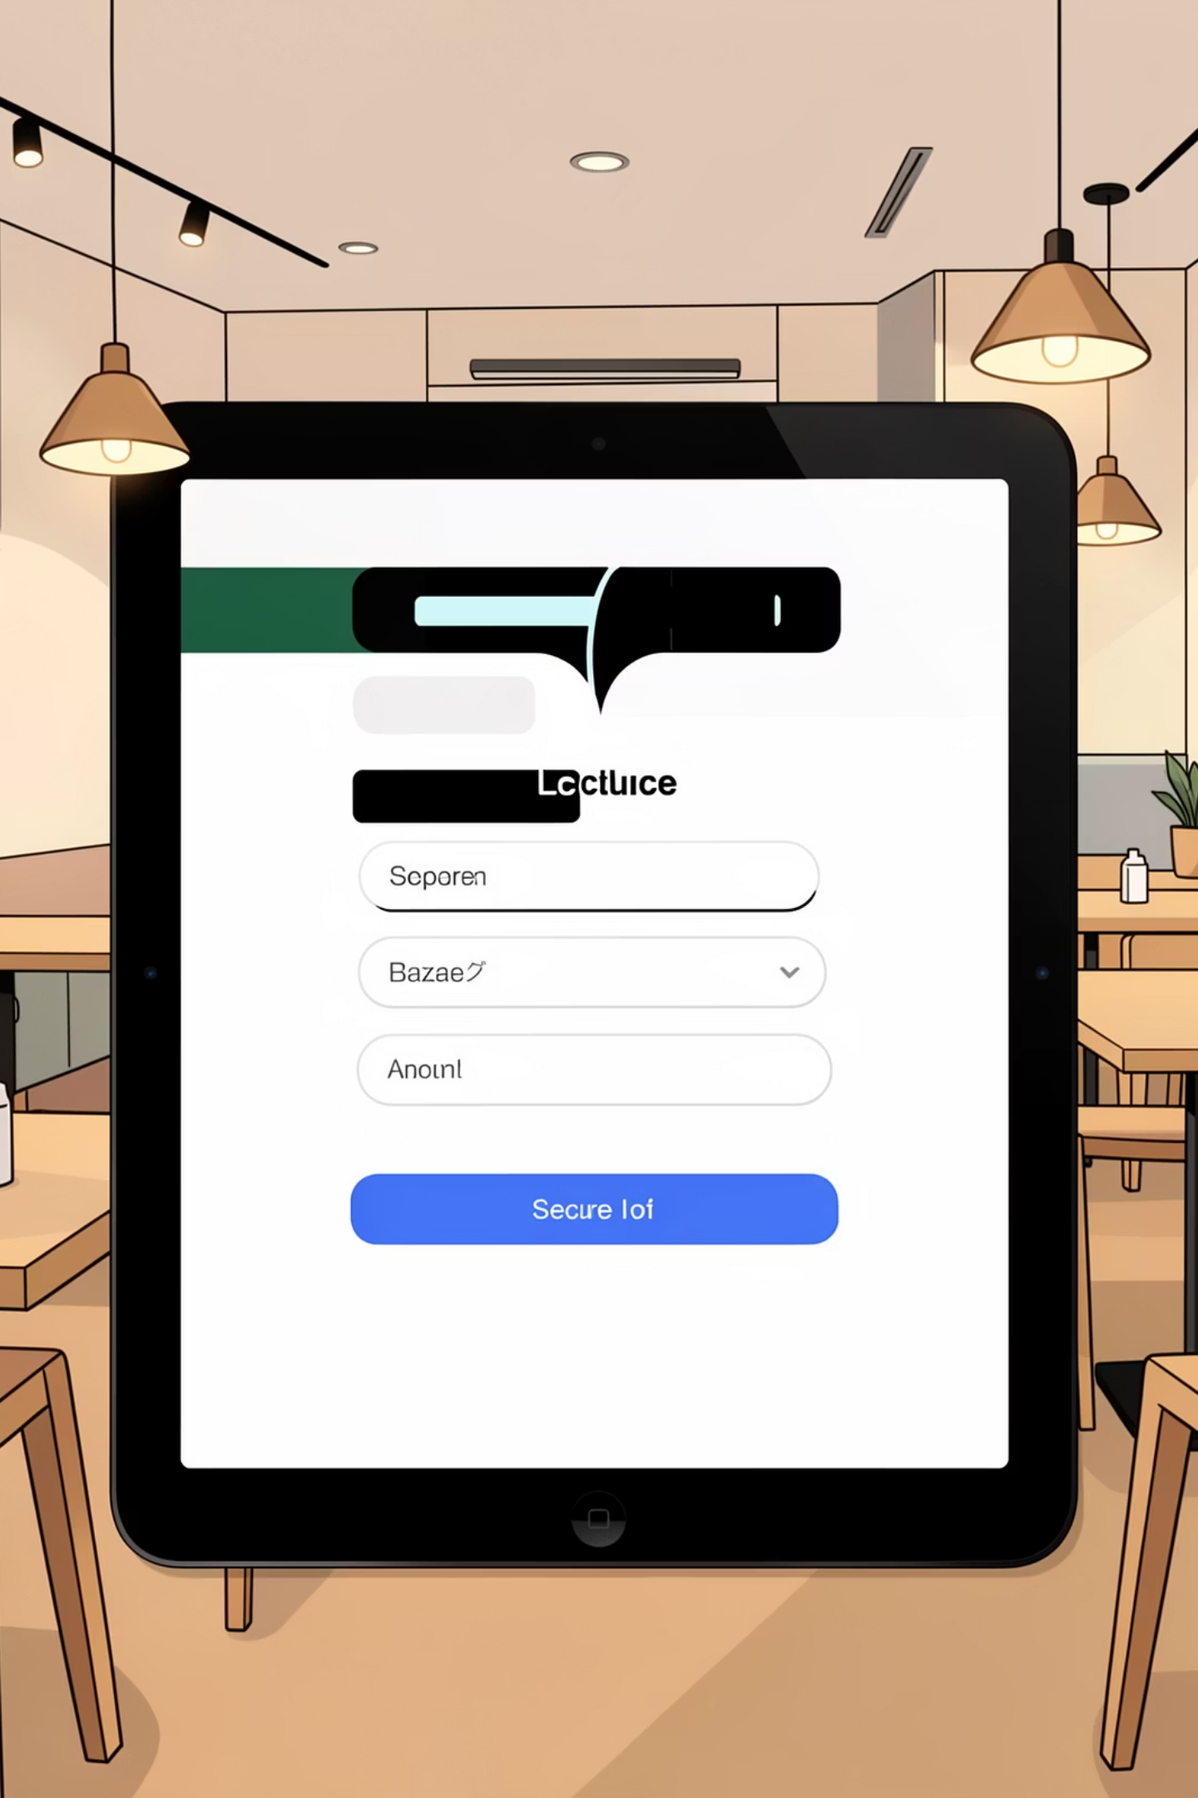

Secure Authentication System
Security forms the foundation of our platform. We've implemented a comprehensive authentication system using industry-standard JWT (JSON Web Tokens) to ensure every interaction is verified and protected.
01
User Registration & Login
Streamlined onboarding process with secure credential storage and validation
02
JWT Token Generation
Encrypted tokens issued upon successful authentication for session management
03
Role-Based Access Control
Distinct permissions for Admin and Staff roles ensuring appropriate system access
04
Middleware Protection
Every API endpoint secured through verification middleware preventing unauthorized access

Slide 7

Core Features: Restaurant & Menu Management
Comprehensive Control
Multi-Branch Support
Restaurant owners gain complete control over their digital presence with intuitive management tools designed for efficiency.
Create and manage multiple restaurant locations from a single dashboard, each with unique settings and configurations.
Dynamic Menu Management
Add, update, or remove menu items in real-time. Changes appear instantly across all connected devices and QR codes.
Visual Menu Presentation
Upload high-quality images for every menu item making dishes more appealing to customers.
Smart Categorization
Organize menu items by categories (appetizers, entrees, desserts, beverages) for intuitive customer browsing.

Slide 8
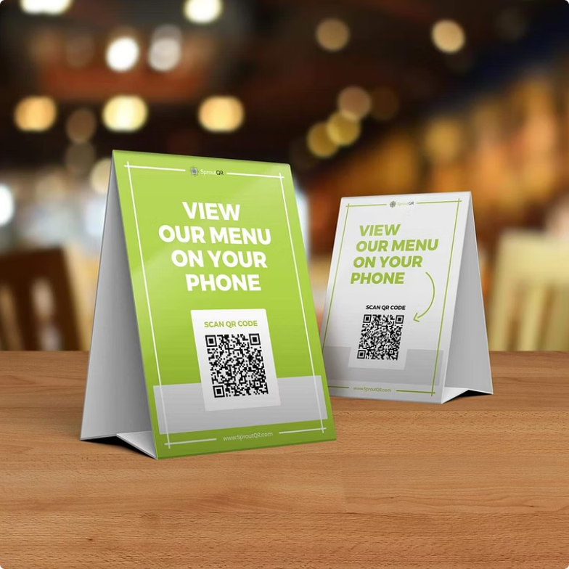
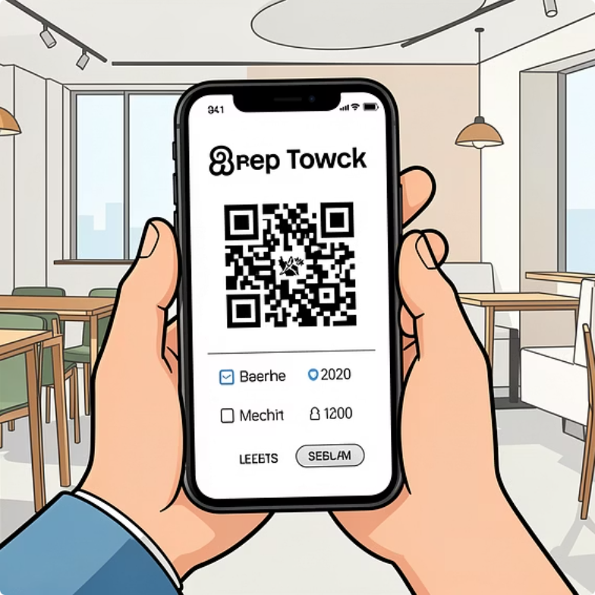
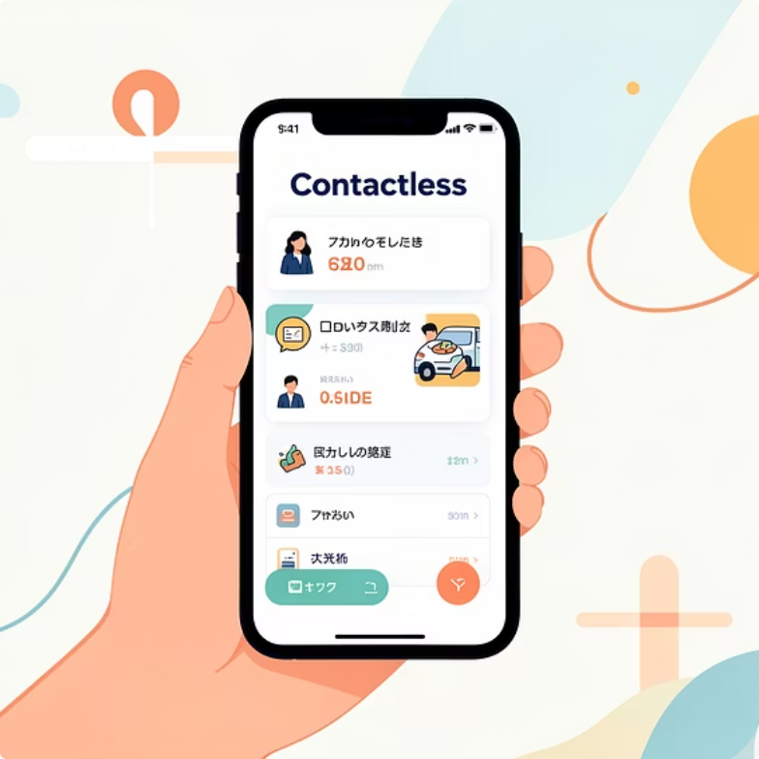
INNOVATION
Revolutionary QR Code System
Unique Table Identifiers
Direct Menu Access
Zero Friction Experience
Every table receives a distinct QR code linked directly to the restaurant's digital menu, enabling precise order tracking and seamless service.
Customers simply scan the code to instantly view the full menu on their personal devices
The contactless ordering process eliminates wait times for physical menus and reduces staff workload, creating a faster, safer dining experience.

Slide 9
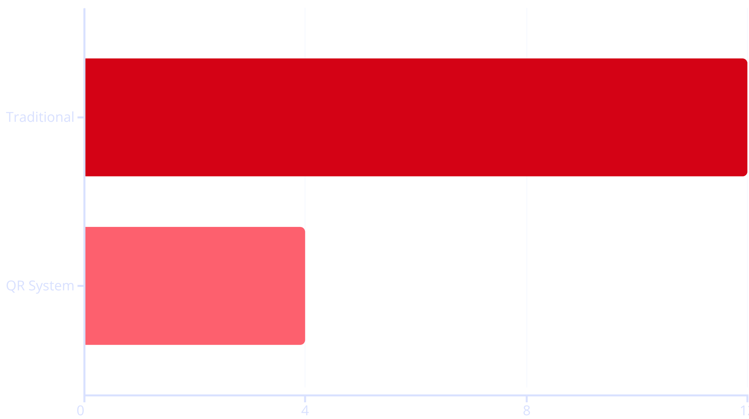
Order & Session Management
From the moment a customer scans a QR code to final bill payment, every step is tracked and managed with precision.
Real-Time Order Flow
Orders placed via QR are instantly transmitted to the kitchen system, eliminating transcription errors and reducing preparation time. Staff can monitor order status from preparation through delivery, ensuring nothing falls through the cracks.
Session-Based Billing
Each table operates as an independent session, accurately mapping all orders to the correct bill. This prevents duplicate charges and ensures no orders are missed, even during busy service periods.
QR-based ordering reduces average order processing time by 67%, significantly improving table turnover and customer satisfaction.

Slide 10
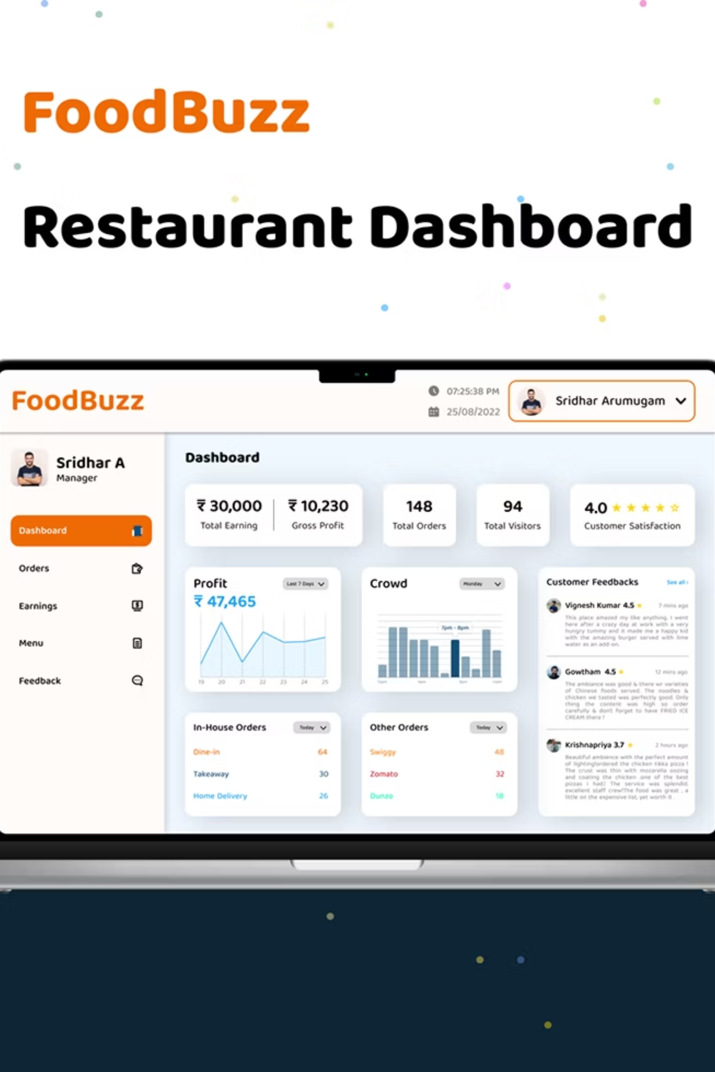
Analytics, Security & Future Vision
Data-Driven Insights
Enterprise Security
Scalable Architecture
Dedicated analytics controller tracks orders, revenue patterns, and performance metrics, empowering owners to make informed business decisions.
JWT validation, protected routes, environment variable management, and secure database connections ensure your restaurant data stays safe.
Built for growth with easy integration paths for payment processing, customer order history, mobile apps, and advanced analytics dashboards.
This complete end-to-end solution combines modern technology with practical restaurant operations, delivering improved efficiency, accuracy, and exceptional customer experiences. Perfect for forward-thinking restaurants ready to embrace digital transformation.

Slide 11
A Complete Solution for the Modern Restaurant
Our platform delivers a seamless blend of technology and hospitality, empowering restaurants to thrive in a digital world
Streamlined Operations
Enhanced Guest Experience
Robust Security
Strategic Insights
Boost efficiency with QR-based ordering, dynamic menus, and real-time management.
Protect data and transactions with comprehensive JWT authentication and access control.
Drive growth with powerful analytics on orders, revenue, and performance.
Offer contactless convenience, faster service, and engaging digital menus.
Scalable for Tomorrow
A flexible architecture ready for future integrations and business expansion.

